Slide 1

Telecom Customer Churn Prediction
MSBA 307 Final Project
Student: Yichun Chen
This Photo by Unknown Author is licensed under CC BY-SA

Slide 2
Business Problem
Customer churn is a big problem in the telecom industry, resulting in profit loss.
It’s more expensive to acquire new customers than to retain existing customers.
Solution:
We can gather customer data and leverage machine learning algorithms to predict whether a customer will churn or not, which will offer a valuable tool for CRM team to target these potential churners by developing effective customer retention strategies to reduce churn rate and minimize the risk of profit loss.

Slide 3
Dataset
Source: Telco Customer Churn dataset from Kaggle: https://www.kaggle.com/datasets/blastchar/telco-customer-churn
Metadata:
7043 rows (unique customers)
Target: “Churn” column: Boolean value indicating if the customer left within the last month
19 features: 16 categorical, and 3 numerical
4 features about customer demographics: 'gender', 'SeniorCitizen', 'Partner', 'Dependents',
9 features related to services that each customer has signed up for – phone, multiple lines, internet, online security, online backup, device protection, tech support, streaming TV and streaming movies
6 Customer account information – “tenure” (how long they’ve been a customer), “contract” (monthly, 1 year, 2years), “payment method”, “paperless billing”, “monthly charges”, and “total charges”

Slide 4
Solution Process
Data collection and data wrangling
Exploratory Data Analysis (EDA): to explore the impacts of different features on the target
Data pre-processing steps before modeling: OneHotEncode all categorical features, and standardize all numeric features
Implement two machine learning algorithms
- Logistic regression,
Random forest
Evaluate the two models using following metrics
- Recall
F1-score
ROC AUC score
Confusion Matrix

Slide 5
Exploratory Data Analysis (EDA)
EDA was performed in four sections, with an aim to identify any patterns related to:
Target distribution
Impact of demographic features on the target
Impact of service usage features on the target
Impact of account features on the target

Slide 6
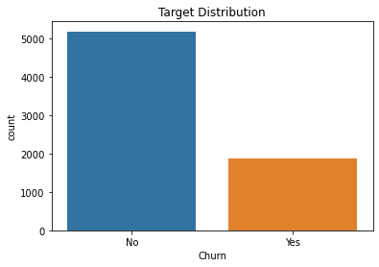
EDA – Target distribution
an imbalanced dataset, with 5174 non-churners and 1869 churners
Binary values – suggests machine learning needs to solve a binary classification problem

Slide 7
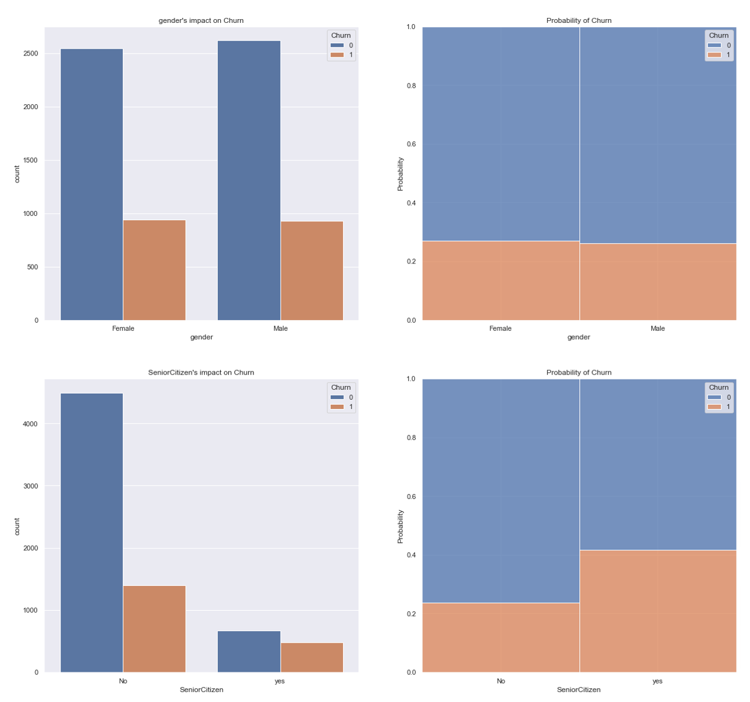
EDA – Demographic Features
Gender: Not much difference was found between male and female
SeniorCitizen: the count plot on the left showed that customers are mostly non-senior citizens; but the probability plot showed that the older people are more likely to churn.

Slide 8
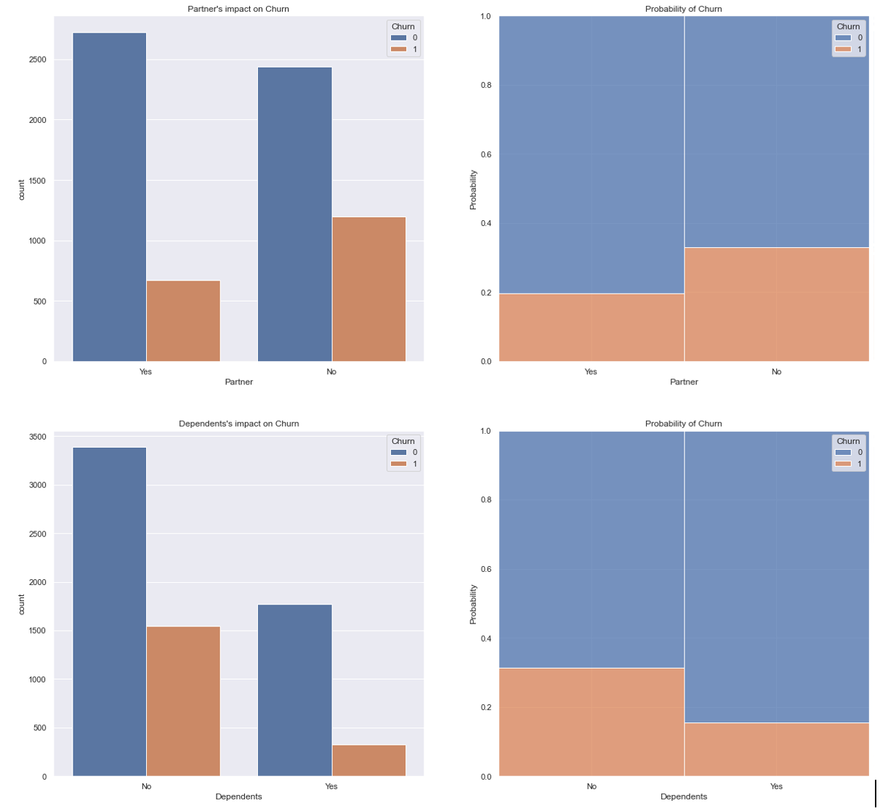
EDA – Demographic Features
Partners: customers without partner(s) are more likely to churn than those with partner(s).
Dependents: customers without dependent(s) are more likely to churn.

Slide 9
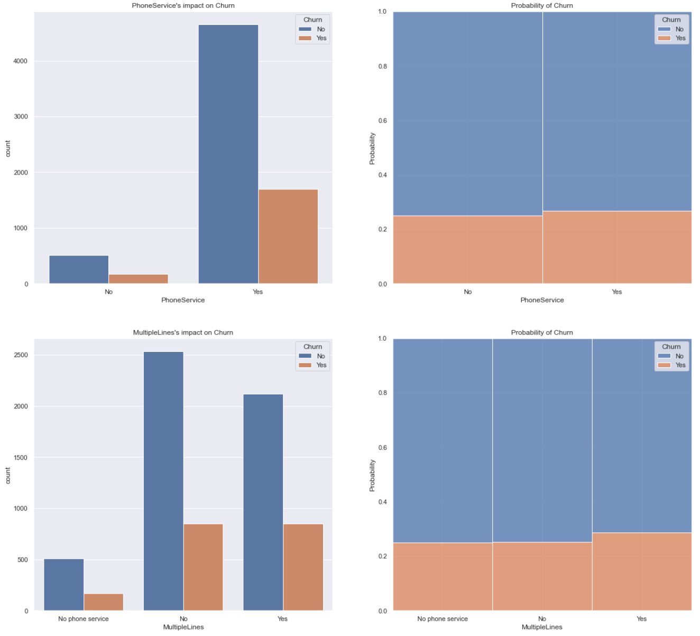
EDA – Service Usage Features
“PhoneService”: most customers used PhoneServices; only a small portion of customers did not have this service. The probability chart on the right shows this feature has no obvious impact on churn probability.
“MultipleLine”: subscription of this service has no obvious impact on churn probability

Slide 10
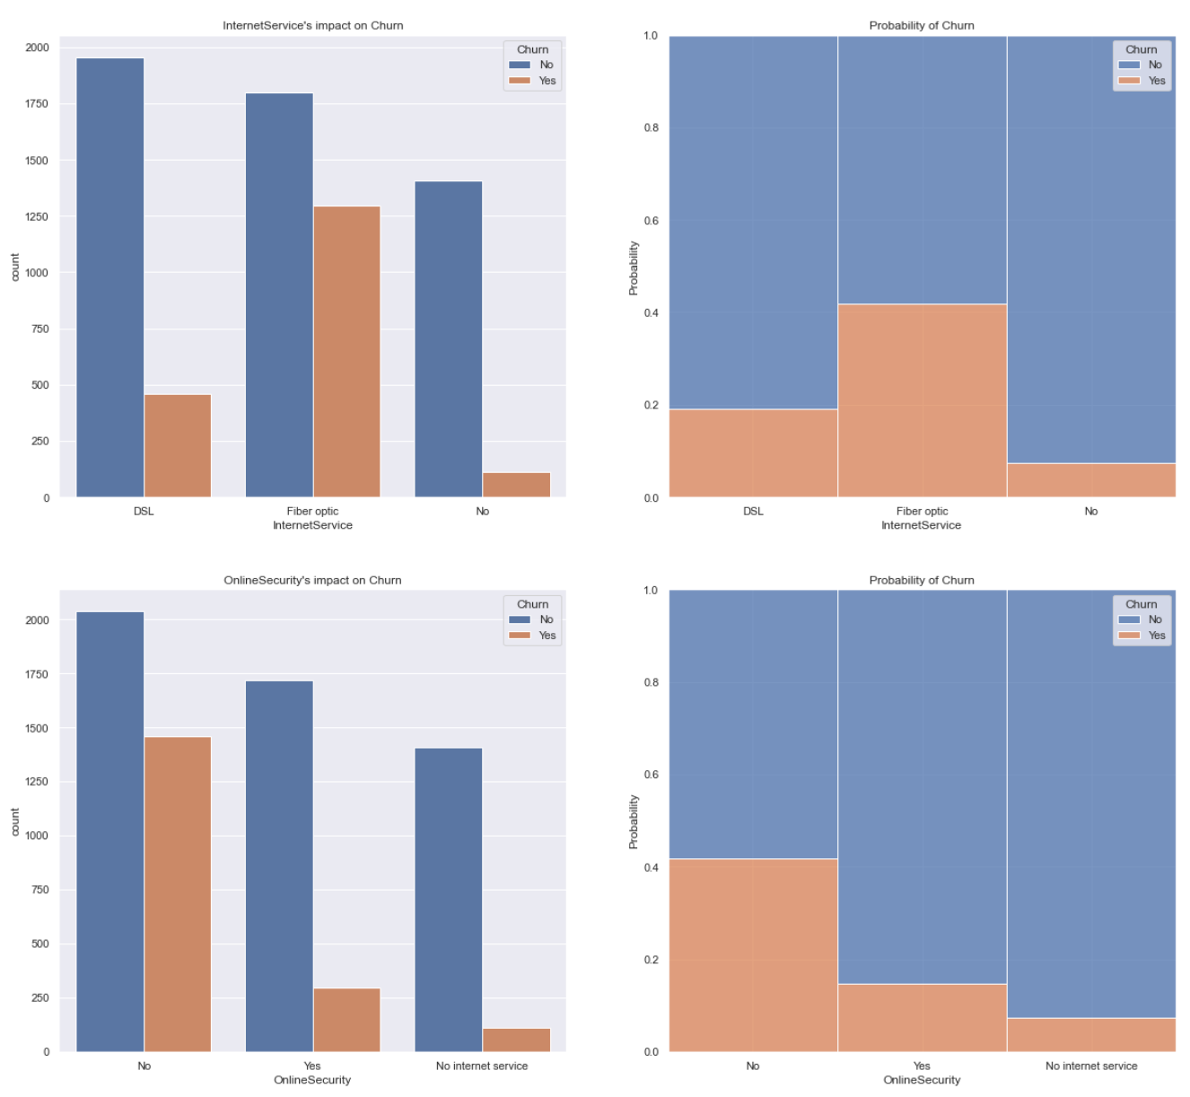
EDA – Service Usage Features
“InternetService”: customers who used fiber optic InternetService are twice likely to churn than those used DSL.
“OnlineSecurity”: customer who did not subscribe for OnlineSecurity service is more likely to churn than people who had this service

Slide 11
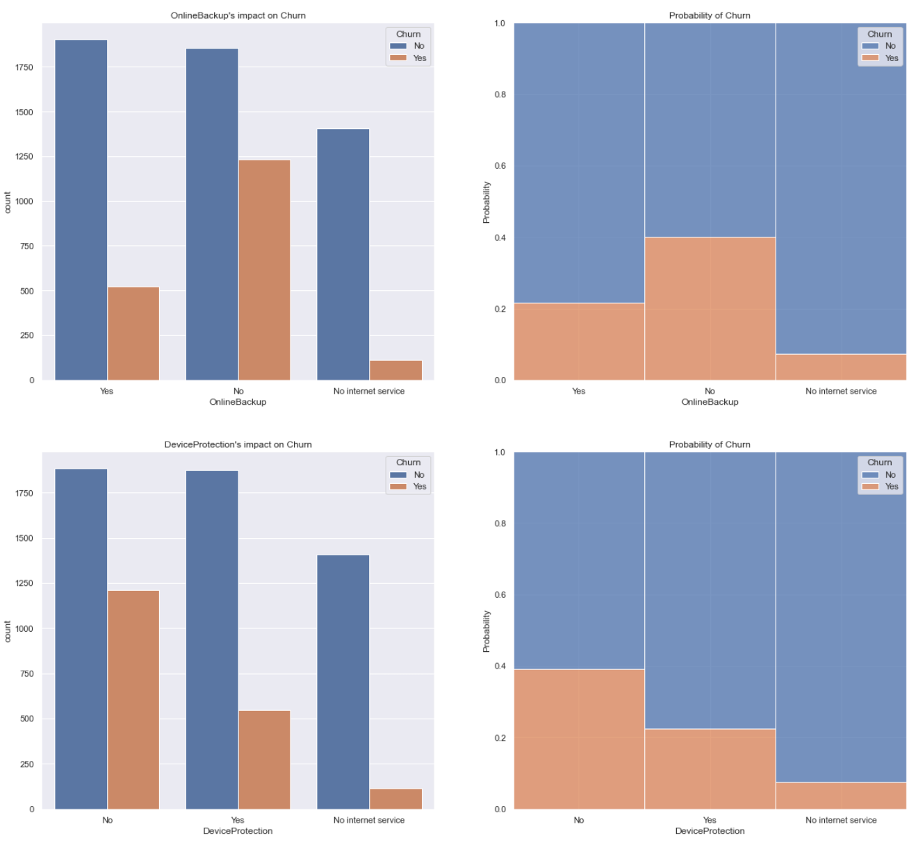
EDA – Service Usage Features
'OnlineBackup’: customer who did not subscribe for OnlineBackup service is more likely to churn than people who have this service
'DeviceProtection’: customer who subscribed for DeviceProtection service is less likely to churn than people who did not have this service

Slide 12
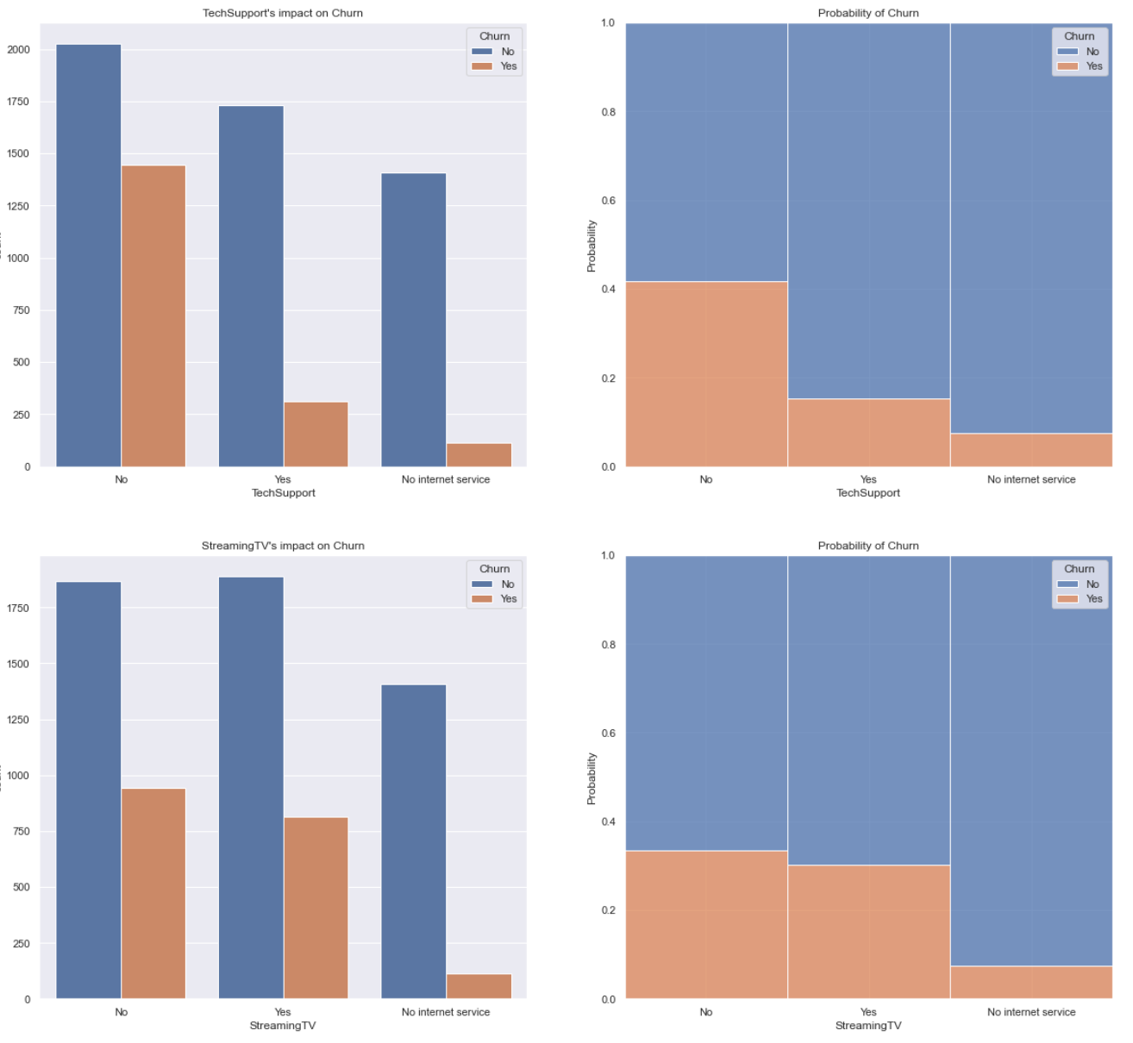
EDA – Service Usage Features
‘TechSupport’: customer who did not subscribe for TechSupport service is more likely to churn
‘StreamingTV’: has no obvious impact on churn probability

Slide 13
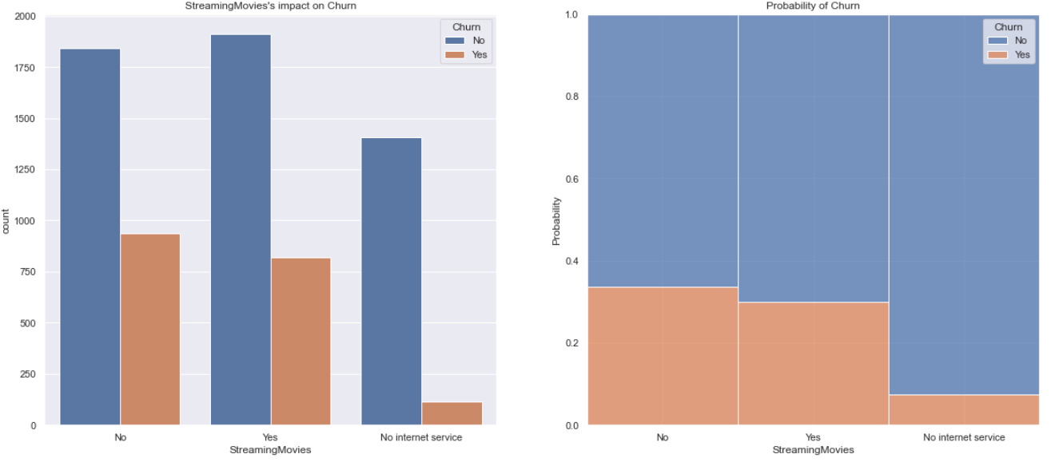
EDA – Service Usage Features
‘StreamingMovies’: has no obvious impact on churn probability

Slide 14
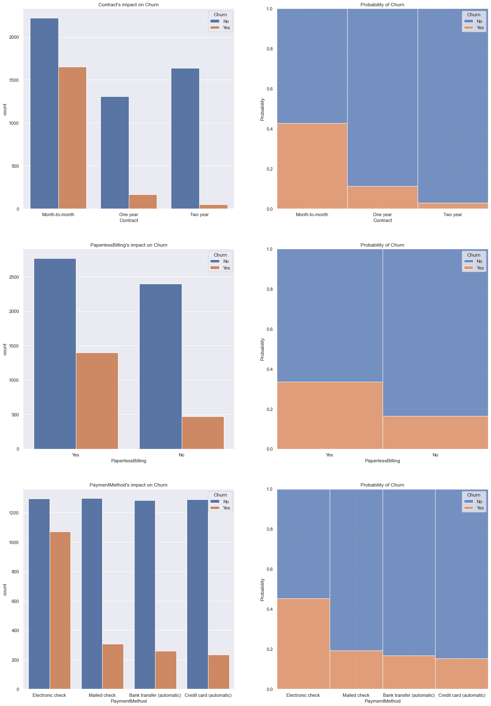
EDA – Account Features
“Tenure”: tenure seems to be negatively correlated with churn, which is logical as customers who have stayed with the company for a longer time are usually less likely to churn.
“MonthlyCharges”: no clear pattern except that customers who paid very little or very much are less likely to churn.
“TotalCharges”: one unexpected insight was revealed: total charges is negatively correlated with churn. It may be because loyal customers subscribe a lot more services and thus incur higher charges.

Slide 15
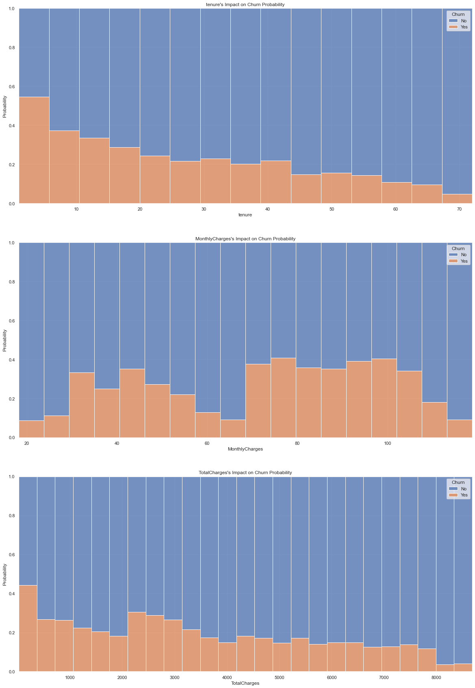
EDA – Account Features
“Tenure”: tenure seems to be negatively correlated with churn, which is logical as customers who have stayed with the company for a longer time are usually less likely to churn.
“MonthlyCharges”: no clear pattern except that customers who paid very little or very much are less likely to churn.
“TotalCharges”: one unexpected insight was revealed: total charges is negatively correlated with churn. It may be because loyal customers subscribe a lot more services and thus incur higher charges.

Slide 16
AI Modeling
This part includes:
Column transformation:
- One Hot Encode all the categorical features
- Standardize all the numeric features
Model training: two AI models
- random forest
- logistic regression
Model evaluation
Recall
f1-score
ROC AUC score
confusion matrix

Slide 17
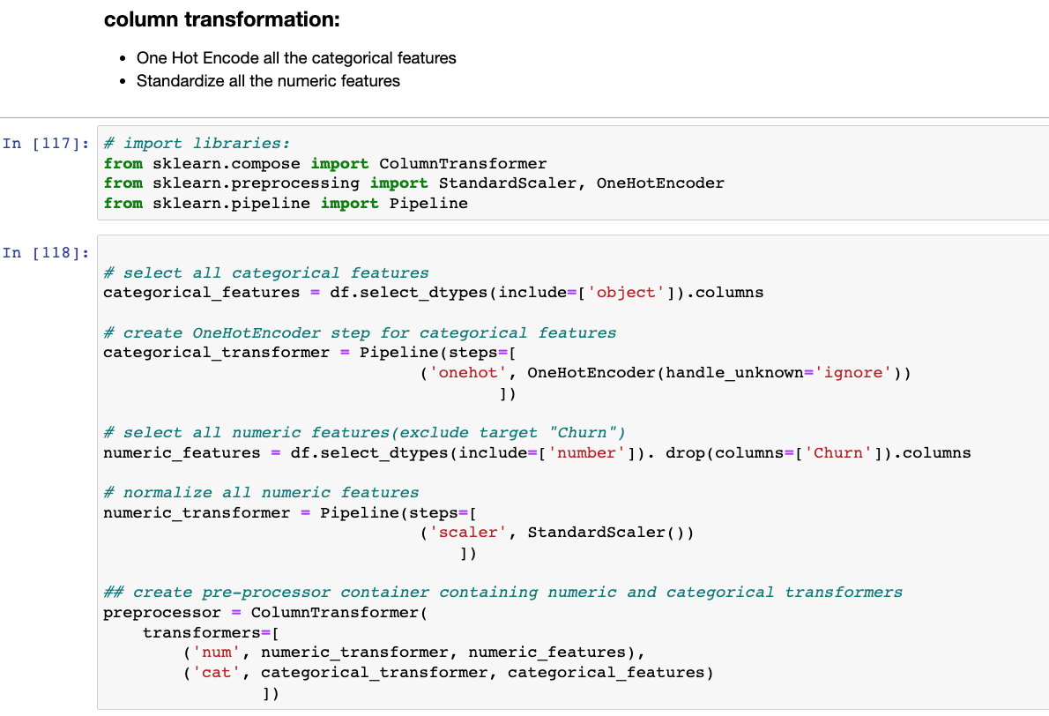
Column Transformation
Data was prepared for modeling, such as encoding all categorical features using OneHotEncoder and scaling all numerical features using StandardScaler.
I used the ColumnTransformer and the Pipeline tools from sklearn to make the process more streamlined

Slide 18
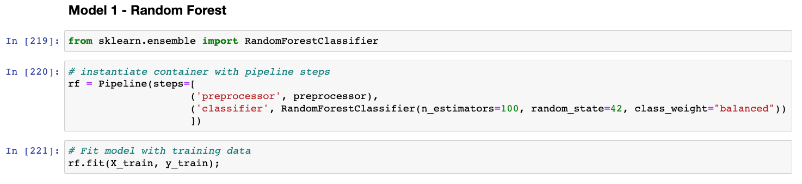
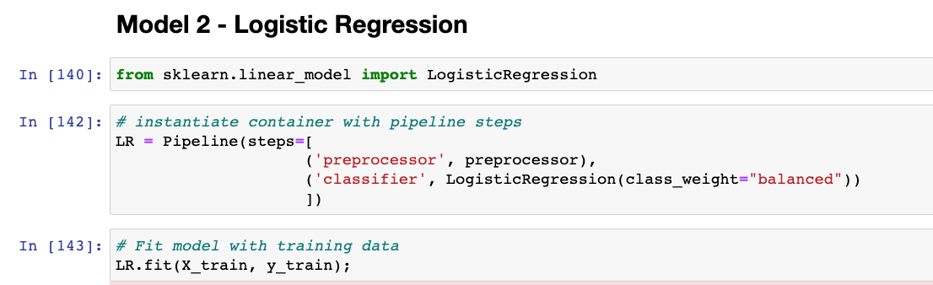
Model training
Dataset was split into training set and test set.
The training dataset was used to train two machine learning algorithms: random forest and logistic regression.
Use class_weight="balanced" parameter since the EDA showed the target label was imbalanced.

Slide 19
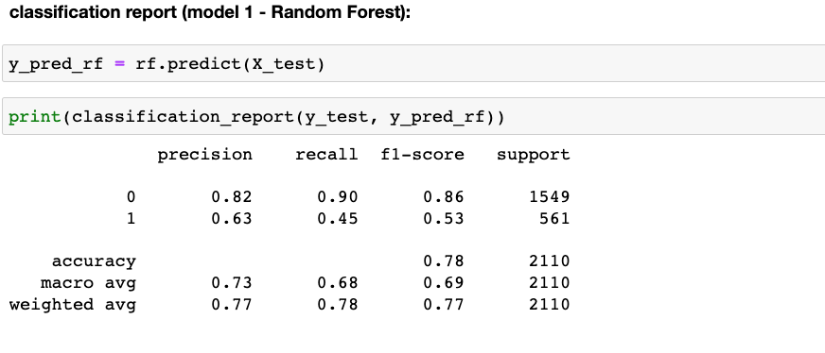
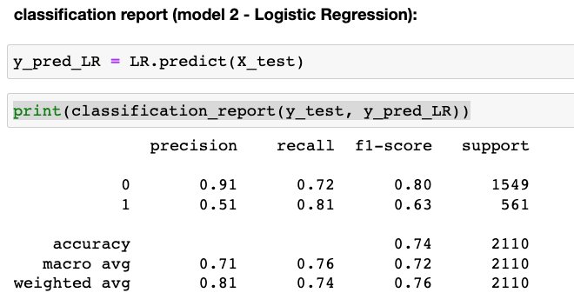

Evaluation of Model Performance: Recall and F1-score
Label 1 is our focus
“recall” metric is more important than “precision” as it’s more costly to miss-classify a churner into non-churner than the other way round – We want to identify as many potential churns as possible
random forest performs not as well as logistic regression in terms of “recall” and “F1-score” for label 1(churn): random forest has a recall of 0.45, much lower than 0.81 from the logistic regression. Logistic regression’s f1-score 0.63 also outperforms that of random forest (0.53). Therefore, in terms of both recall and f1-score, logistic regression is the winner.

Slide 20
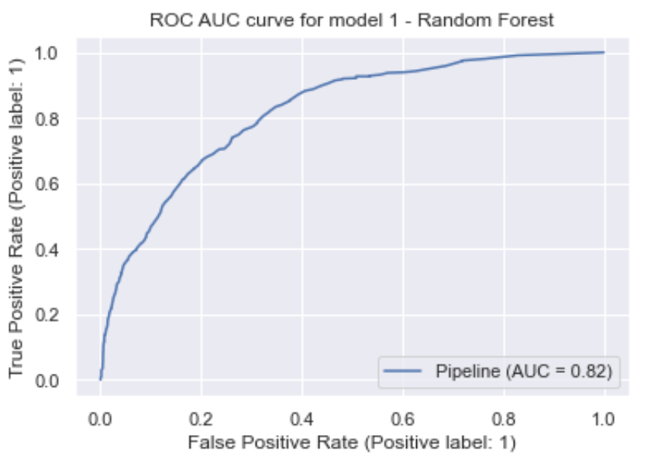
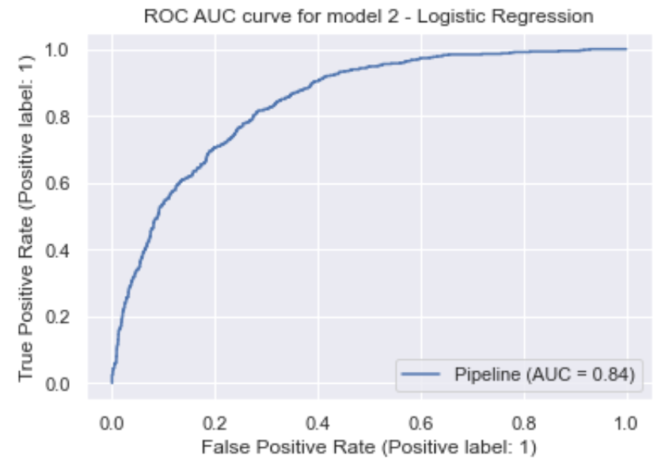



Evaluation of Model Performance: ROC AUC
Logistic Regression’s ROC AUC score is 0.84, slightly higher than that of random forest (0.82).

Slide 21
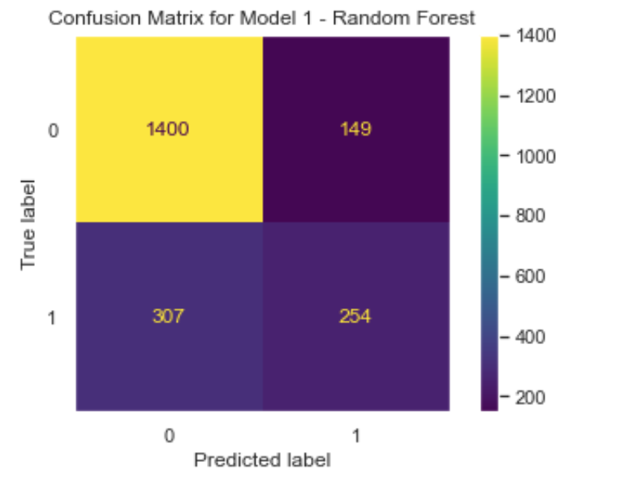
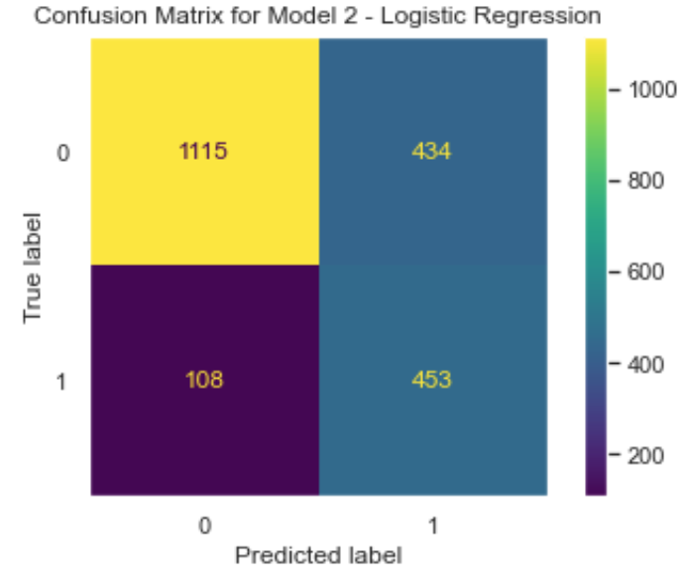


Evaluation of Model Performance: confusion matrix
model 2 (logistic regression) is able to identify churners much better than random forest, with only 108 cases missed, about one third (1/3) of the misclassification cases by random forest (307).

Slide 22
Evaluation of Model Performance: conclusion
Based on the evaluations, it’s concluded that model 2 (logistic regression) outperforms model 1 (random forest) for this dataset and should be selected for churn prediction.
This AI algorithm helps to boost the churn prediction rate from its base rate of 0.27 (1869 churners / 7043 total customers = 0.27%) to 0.81% (recall), offering great value to the CRM department for designing client retention programs.

Slide 23
Conclusion
This project compared two machine learning algorithms - random forest classifier and logistic regression classifier – in predicting whether a customer will churn or not.
The logistic regression model is the winner for this dataset based on performance metrics such as recall, f1-score, ROC AUC score, and confusion matrix.
The project has successfully demonstrated that machine learning algorithms can be applied to reduce risk for an organization. Prediction of customer churn in telecom industry helps the firm identify potential churners in advance and then target these customers with effective retention programs, thus reducing the churn rate and minimizing the risk of profit loss.

